Slide 1






Slide 2


INF 112
OBLIG 5
GROUP 6
TEAM PRESENTATION

Slide 3



GRUPPE 6
Sverre – Code
Loc - Graphics
Benjamin – SQL
Eirik – Code
Stian – AI & Version control
Vegard – Documentation & UI
Robin E – UI
Robin G – UI
1
of
8

Slide 4
RESULTS &
CHALLENGES
Fire-chess
Sjadam
Online game
Improved workload distribution
Refactoring
2
of
8

Slide 5
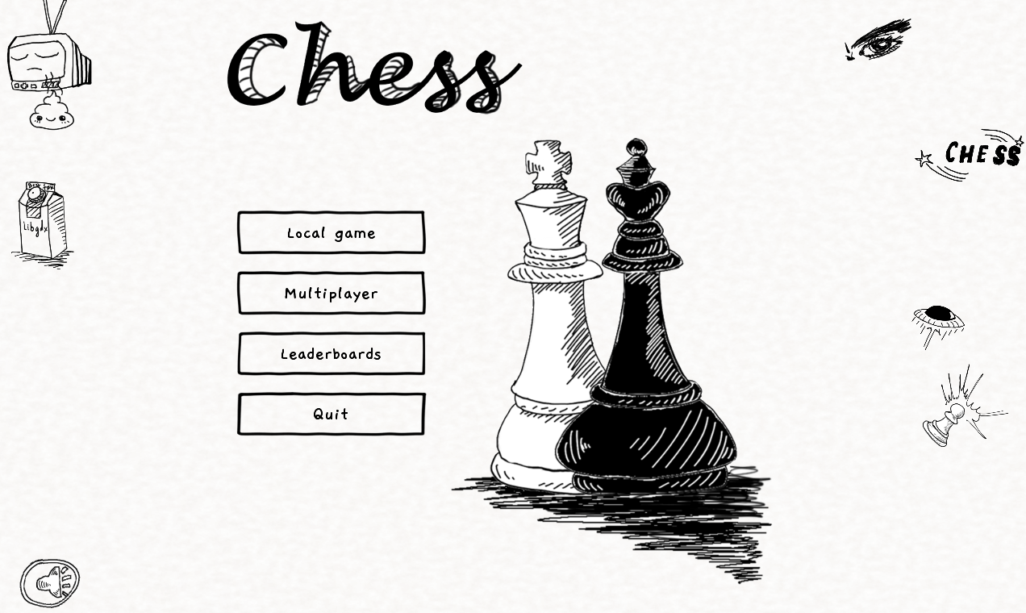
3
of
8

Slide 6
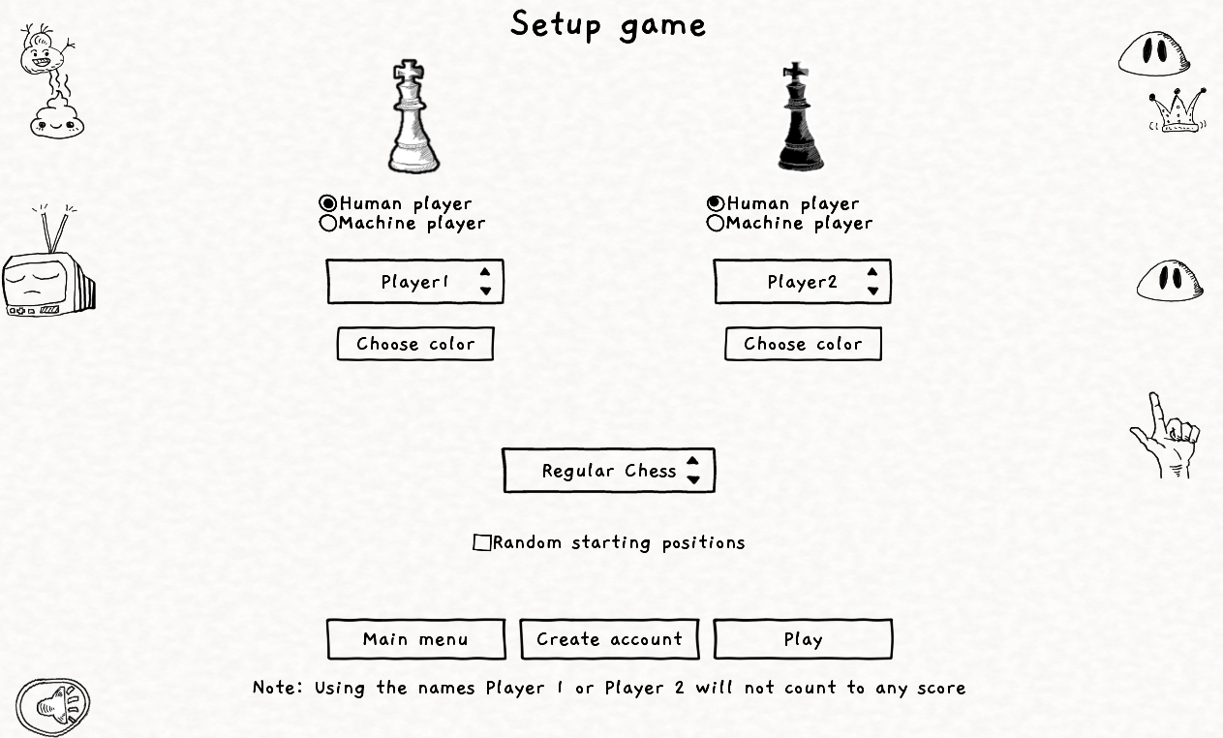
4
of
8

Slide 7
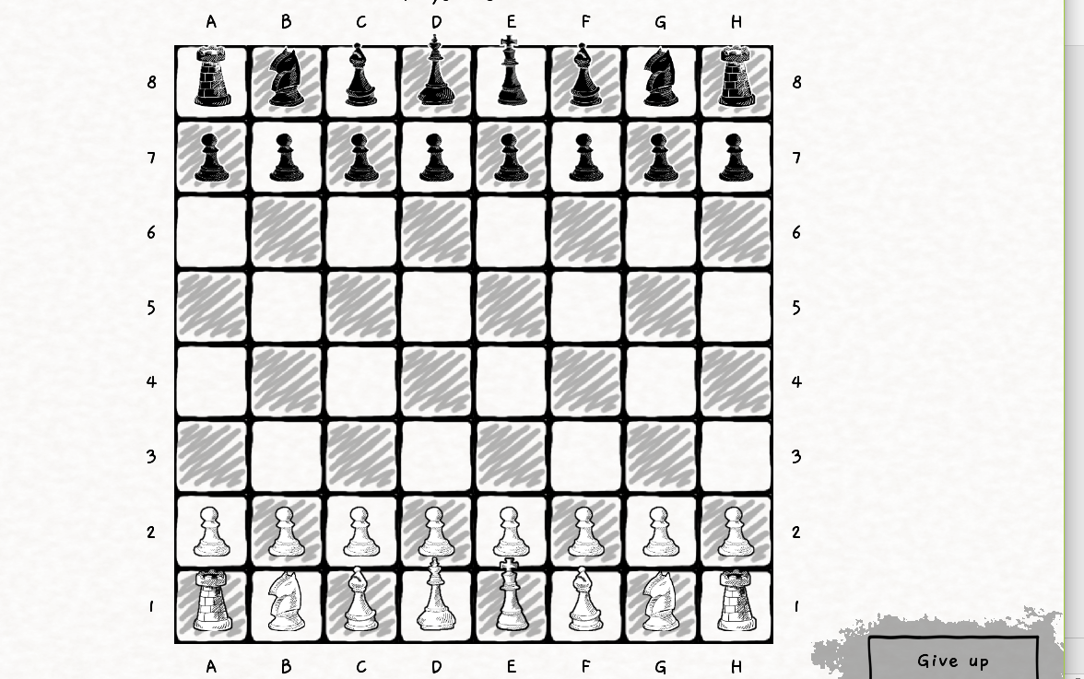
5
of
8

Slide 8
DEMOVIDEO
6
of
8

Slide 9
Retrospective
..
..
..
7
of
8

Slide 10
THANK YOU

